Slide 1
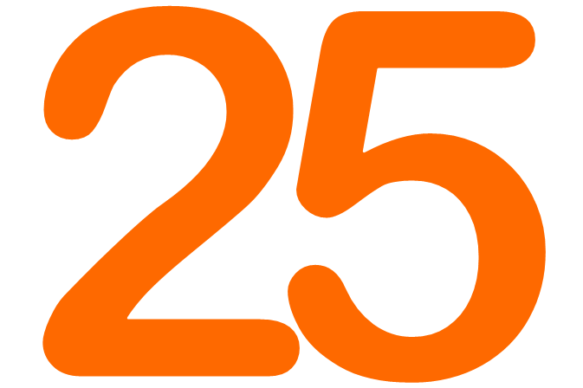
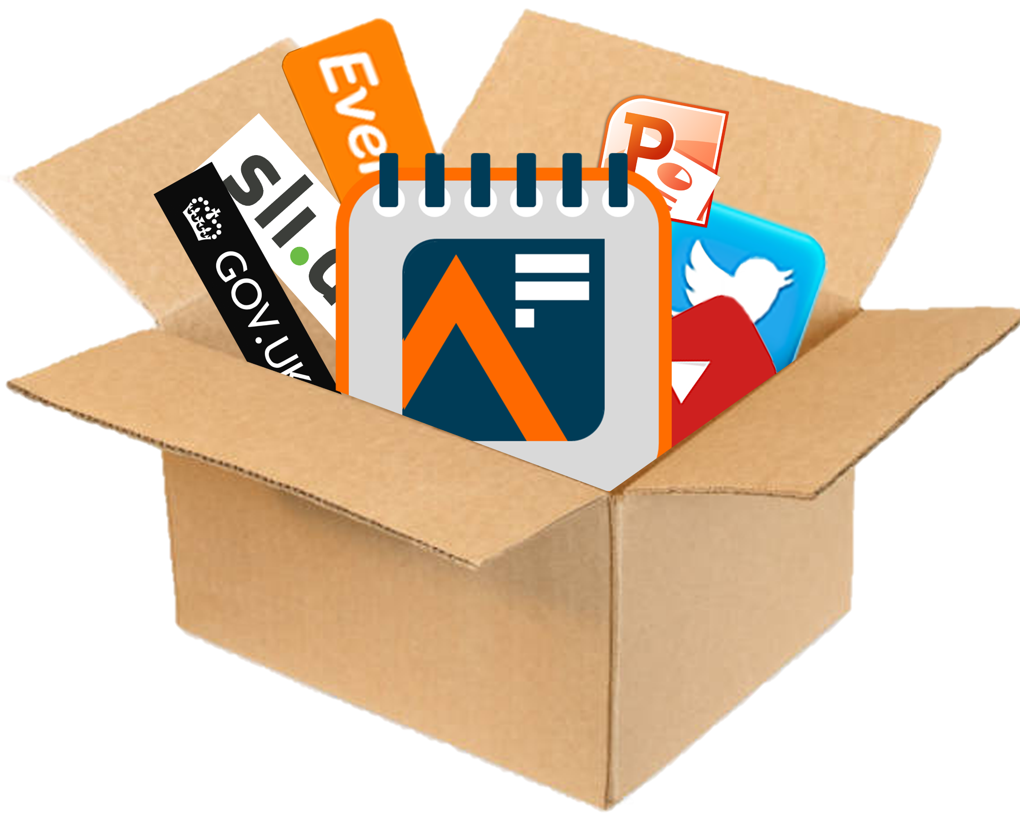
Analysis in Government Month
AiG Month
1-31 May 2025
‘Campaign in a Box’
For Analysis Function leaders, AF Champions, Communications teams, and Business Support teams
The UK’s largest learning & development event for government analysts

Slide 2
About Analysis in Government (AiG) Month
Analysis in Government Month is the UK’s largest learning and development event for government analysts and takes place every May.
AiG Month is first and foremost a learning event, featuring live events, L&D resources, blogs, interactive activities, and much more going on throughout May.
Whilst content is designed with government analysts in mind, everyone interested in sharing or developing their analysis skills is welcome to join in with AiG Month.
All our live events are virtual, meaning everyone can dial in no matter where they’re based.
Events take place throughout May on Tuesdays, Wednesdays and Thursdays, starting at 10, 12, and 2, so you’ll always know when to tune in.
Hundreds of colleagues from more than 50 government departments, academia, and the private sector have already presented engaging and educational events to thousands of attendees at AiG Month. Why not join them by expressing an interest in delivering a session this year?
All activities and content will be listed on our new AiG Month Hub, but make sure to also sign up to our monthly newsletter, LinkedIn, and X @gov_analysis for all the latest news, and follow us on Eventbrite to be the first to find out about events.
The Analysis Function is a cross-government community of 17,000 analysts from all the analysis professions. Our members work in every government department and are actuaries, digital and data analysts, economists, geographers, operational researchers, social researchers, statisticians, are ‘dual-badged’, ‘unaffiliated’, or work with analysis.

Slide 3
Analysis in Government (AiG) Month
1-31 May 2025

Slide 4
Using this Campaign in a Box
Analysis in Government Month (AiG Month) is the UK’s largest L&D event for government analysts, is back for the fifth year. This year’s theme is impact
AiG Month 25 will highlight the importance of government analysts in making a positive difference – to decision making, to policy formation, and to delivery of government services that we all use
AiG Month features skills-based sessions led by members of the Analysis Function membership. Last year we had 35 live events delivered by colleagues from numerous departments including GCHQ, National Audit Office (NAO), Office for National Statistics (ONS), and many more.
More than 8,000 tickets were ‘sold’ for AiG Month 2024, with thousands of colleagues dialling in to develop their skills
During the month we will share L&D, hints and tips, and experiences from analysts of all grades across government, so we can all learn to maximise our personal and professional impact
The products within this Resource Pack are designed to help you to promote the event within your department, show people how to get involved, and ensure a joined-up approach
The resources are designed to be used in a ‘pick and mix’ style, allowing freedom for you to do what is best for your teams
We hope that you find these useful and if you have any queries or feedback, please contact the team at Analysis.Function@ons.gov.uk
The Analysis Function is a cross-government community of 17,000 analysts from all the analysis professions. Our members work in every government department and are actuaries, digital and data analysts, economists, geographers, operational researchers, social researchers, statisticians, are ‘dual-badged’, ‘unaffiliated’, or work with analysis.

Slide 5
Theme: Impact
The theme of AiG Month is impact
AiG Month will focus on:
Making a positive impact across government
Helping government make informed, evidence-based decisions
Communicating the results of your analysis effectively to influence different audiences, such as Policy Profession, Operational Delivery Profession colleagues, Ministers, or even the general public
And much more!
Learn directly from a diverse range of government analysts (and speakers from the outside world), access exclusive Learning and Development (L&D) resources and blogs, or get involved in an interactive session…
The Analysis Function is a cross-government community of 17,000 analysts from all the analysis professions. Our members work in every government department and are actuaries, digital and data analysts, economists, geographers, operational researchers, social researchers, statisticians, are ‘dual-badged’, ‘unaffiliated’, or work with analysis.

Slide 6
A message from Sir Ian Diamond
“As Head of the Analysis Function I’m now very much looking forward to Analysis in Government (AiG) Month returning once again.
Throughout May analysts from across government will share their skills and experiences in live virtual sessions, demonstrations, and presentations. I’m excited that this year’s theme is “Impact”. Analysis Function members include every government analyst, and the impact of your work is considerable; on policy formation, on operational delivery, and ultimately on the public services that we all use every day.
If you have something to share that could help develop the skills of other analysts and build the Analysis Function community, do express an interest in presenting. And I encourage everyone to dial into as many sessions as possible throughout the month to engage with and learn from your cross-government peers.
By participating in AiG Month, you will develop your analysis skills, expand your professional network, and gain inspiration from colleagues across the government. I strongly encourage you to sign up and take advantage of this valuable opportunity”.
Professor Sir Ian Diamond
Head of Government Analysis Function, National Statistician, Head of Government Statistical Service

Slide 7
Timings
Events take place every Tuesday, Wednesday, and Thursday during May 2025.
Events are all virtual, and start at 10:00, 12:00 and 14:00 (“Ten, Twelve, and Two”), so you’ll always know when to tune in.
10:00
12:00
14:00

Slide 8
Community programme
Want to run your own event for AiG Month 25?
Already got something going on for Learning at Work Week?
Got something that’s only for specialists?
Then let us know about it and we’ll promote it as part of our Community Programme
We’ll help to promote all Community Programme events in the run up to and during AiG Month, and offer you support by providing graphics, top tips, and links to more information on running an event.
By holding a Community Programme event you’ll be helping to build a greater sense of community, cross-government interaction and engagement, and opportunities to share best practice with an audience of 17,000 government analysts
If you are hosting a live event or webinar during May that would be of interest to government analysts, contact us so we can help promote it
Email us at Analysis.Function@ons.gov.uk

Slide 9
Social Media
The Analysis Function Central Team will be active on X and LinkedIn in the build-up and throughout AiG Month 2025.
You can help us make an even bigger innovation by interacting and engaging with us on social media. Every time you retweet, like, or even look at our content, it makes an innovation on the algorithm and makes it more likely more people will see our tweets and posts!
So, whether you’re an influencer, or just interested…
Follow us on X at @gov_analysis
Connect with us on LinkedIn at Gov Analysis Function
Retweet, Like and tag us in to help build conversations and increase engagement and interest in the event.
On the next two slides you’ll find some examples of template posts you could use on your own
LinkedIn or X account.

Slide 10
Social Media: template posts
Why not use our template tweets and posts on your departmental / profession / personal social media accounts to join in with AiG Month 2025, and use our campaign to promote things that are going on in your area too?
[Insert department name] is proud to support #AiGMonth25! Join us and other government professionals to learn more about the power of data analysis in improving decision-making. Sign up for events on Eventbrite and visit the Analysis Function AiG Month Hub today! https://analysisfunction.civilservice.gov.uk/analysis-in-government-aig-month-hub/
Are you ready for #AiGMonth25? [Insert department name] is excited to participate in this celebration of data-driven decision-making. Stay tuned for updates on our upcoming events and how you can get involved! @gov_analysis
As part of #AiGMonth25, [Insert department name] will be hosting a session on [insert topic]! Don't miss this opportunity to learn from experts in the field. Sign up on Eventbrite and join us on [insert date and time]. @gov_analysis
[Insert department name] is dedicated to staying up-to-date with the latest innovations including [add example] and we're thrilled to be a part of #AiGMonth25. Check out our website and follow us on LinkedIn for updates on our upcoming events! @gov_analysis
#AiGMonth25 is the perfect opportunity to develop your communication and influencing skills and make a positive impact. Join [insert department name] for our session on [insert topic] on [insert date and time]. Sign up on Eventbrite today! @gov_analysis

Slide 11
Five quickfire questions
We’re always keen to find out more about our members, and AiG Month is a perfect opportunity to do so. Why not answer our five quickfire questions and share your story with your community?
What’s the best thing about being part of the Analysis Function?
What is the highlight of your career so far?
What’s the top piece of advice you would give to someone interested in joining the Analysis Function?
Can you tell us something our audience may not know about you?
Which book / film / music / piece of art has changed your life the most?
Send your responses to us at Analysis.Function@ons.gov.uk
NB: We also welcome blogs, articles, or L&D links about impact

Slide 12
Analysis Function channels
Subscribe to the monthly AF Newsletter
Visit the Analysis Function website
Connect with us on LinkedIn at Gov Analysis Function
Follow us on X @gov_analysis
Subscribe to our YouTube channel YouTube/Government Analysis Function
Be the first to find out about our events at Eventbrite/Government Analysis Function

Slide 13
Logos
Simply select, then Copy + Paste.
Please note - if resizing the logos, please make sure ‘Lock aspect ratio’ is ticked in Format Shape menu to avoid squashing or stretching the logos.
If you require any of these designs in a different format, please contact the team at Analysis.Function@ons.gov.uk
Analysis Function logo
Analysis in Government (AiG) Month logo

Slide 14
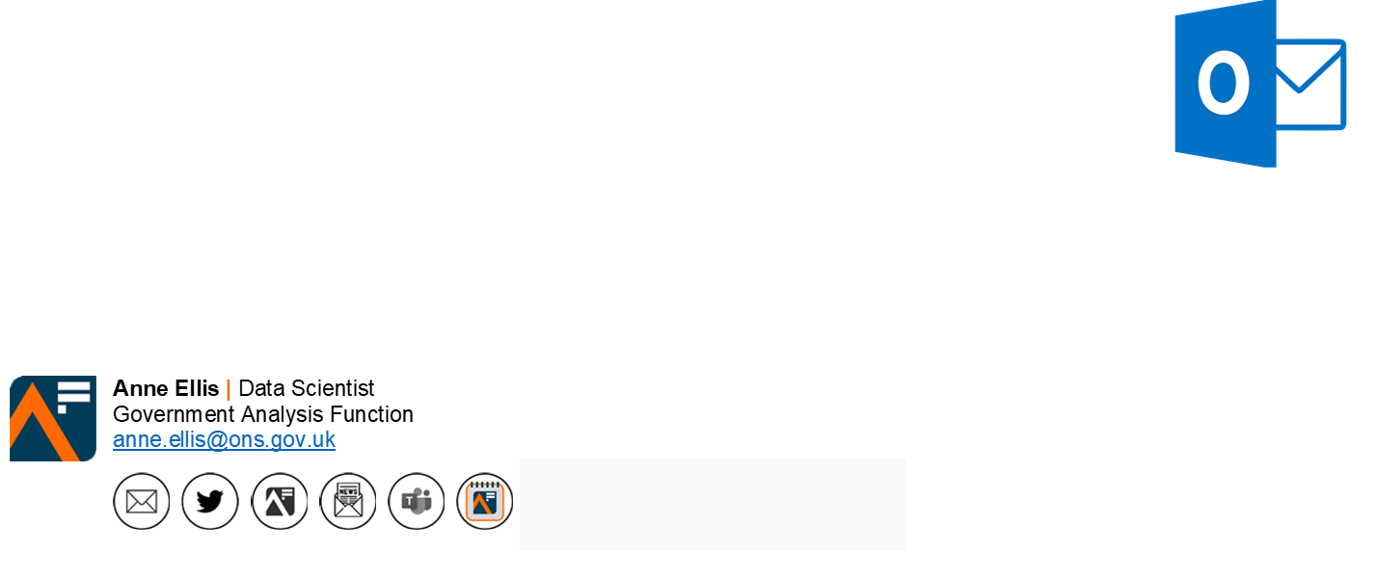
Custom email signature
Add the AiG Month 2025 ‘button’ to your email signature. The button contains a hyperlink to the new Analysis in Government Month hub on the Analysis Function website
Remember to refer to the latest guidance on Understanding accessibility requirements for public sector bodies - GOV.UK (www.gov.uk)
Select, Copy and Paste

Slide 15
Notes:
Gallery Space

Slide 18
Notes:
Chic Office

Slide 19
Notes:
Urban hub

Slide 20
Notes:
Stylish studio

Slide 21
Notes:
Sunny office

Slide 22
Notes:
Sunny office

Slide 23
Notes:
Sunny office

