Slide 1
Presentation and Dissemination Symposium 2020
19 February 2020

Slide 2
Welcome by Julie Stanborough
Chair of the Presentation and Dissemination Committee

Slide 3
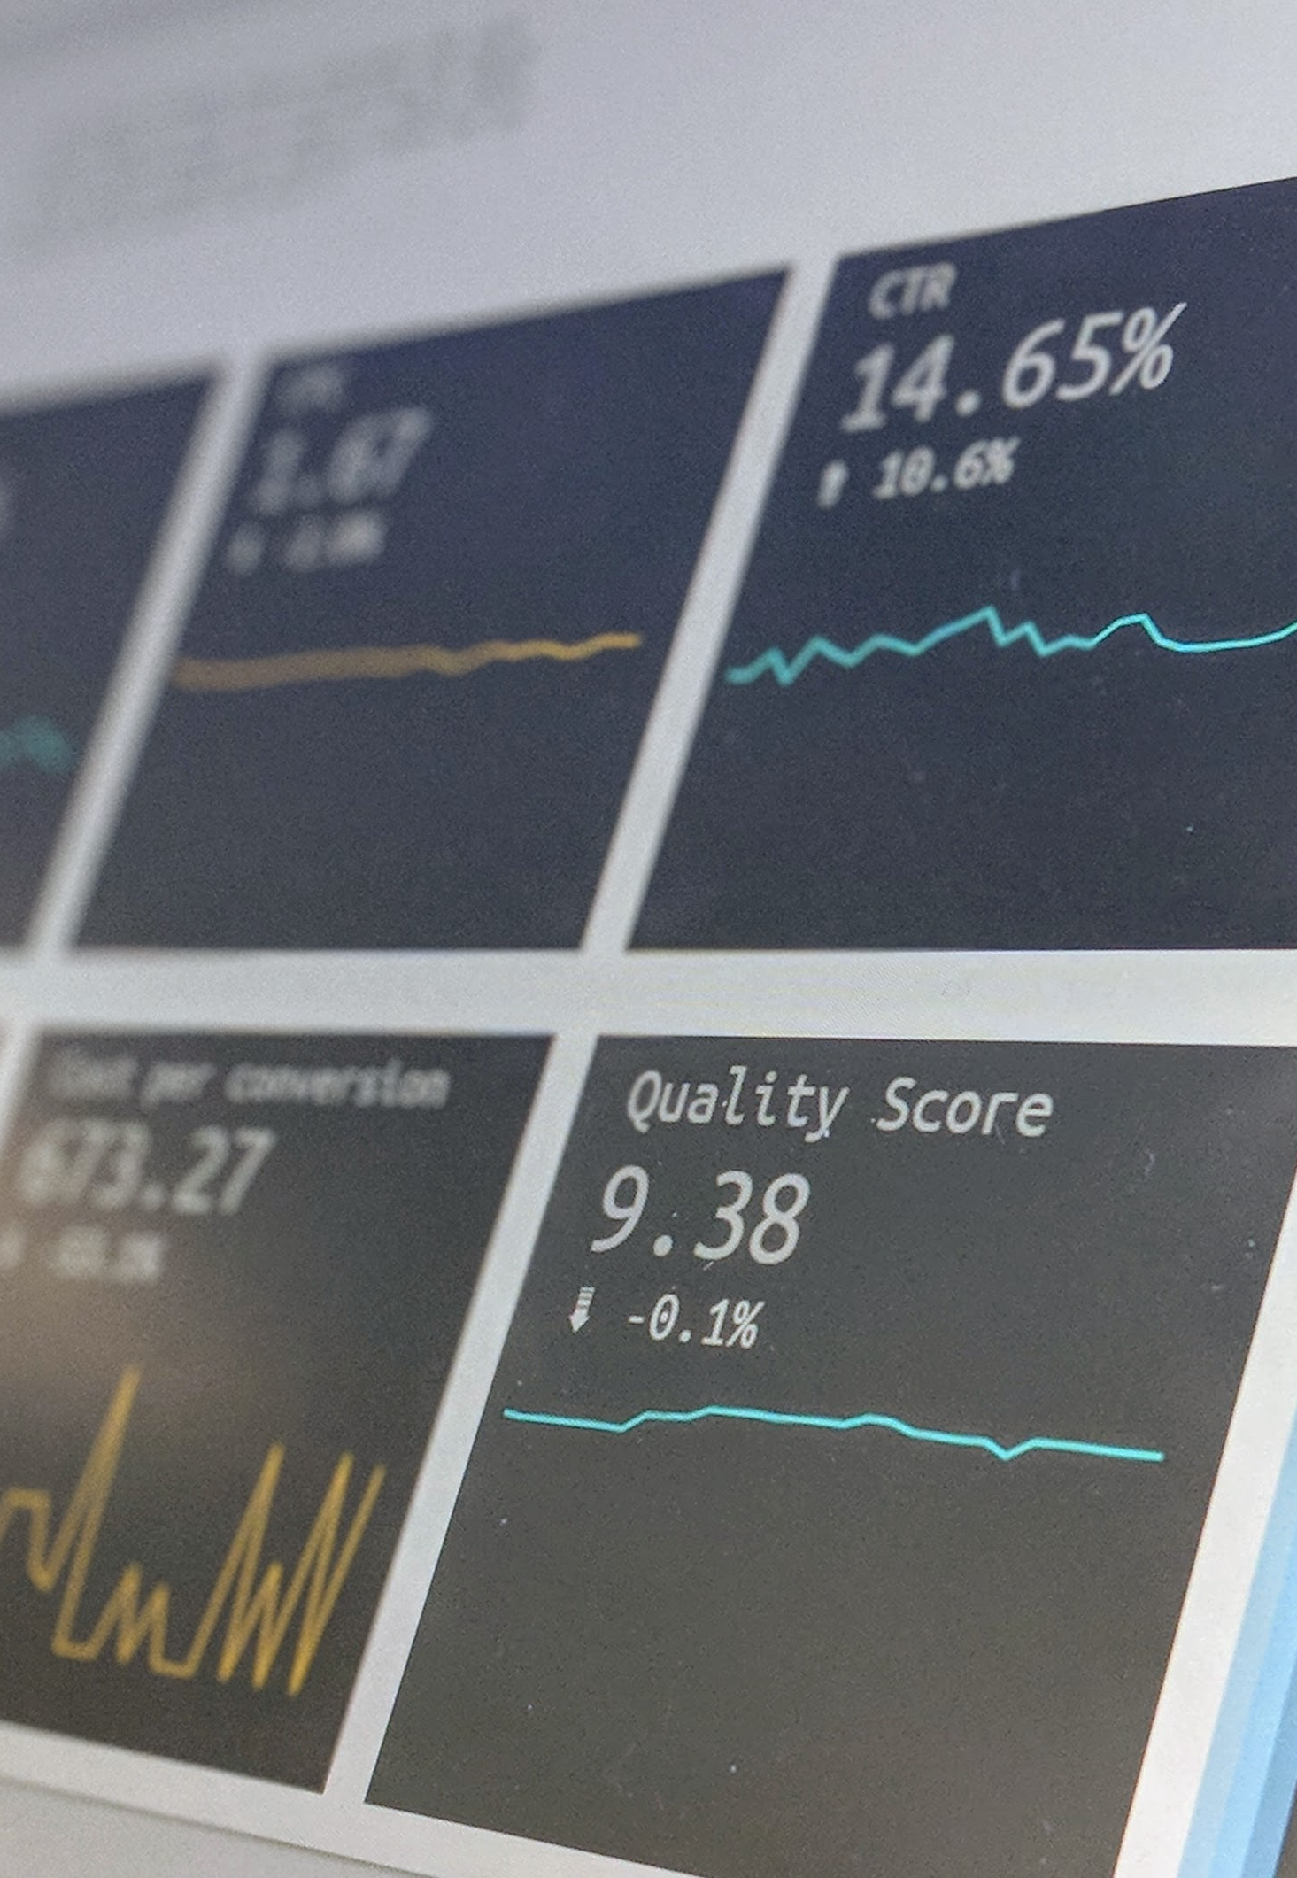

Presentation and Dissemination Symposium
Professor Sir Ian Diamond
National.Statistician@Statistics.Gov.UK

Slide 4
Dissemination Strategies
‘We will disseminate in the usual way’
‘We will disseminate through conference papers and academic publications’
‘When we have finished the work we will plan a dissemination strategy’
‘That sounds like an interesting thing to do’
These were simulated!!!

Slide 5
Dissemination: some thoughts
Dissemination strategy is as important as research strategy
Do I want to make a difference?
  If no, then why are you doing this?
  If Yes then continue below:
    1. Involve the potential beneficiaries from day zero
    2. Plan how best to enable them to influence the work
    3. Plan an ‘in project’ dissemination plan
    4. Have a clear view of who are the key influencers/stakeholders

Slide 6
Multiple Strategies give Multiple Benefits
You often need to think through multiple approaches to get real impact
Eg
Clements, S., Stone, N., Diamond, I.D. and Ingham, R. Modelling the spatial
variation of teenage conceptions in Wessex. British Journal of Family Planning, 24,
1998, 61-71.
` Diamond, I.D., Ingham, R., Clements, S. and Stone, N. Multilevel modelling of the
spatial variation in teenage pregnancy outcomes in Wessex. Journal of Royal Statistical
Society, Series A, 162, 1999, 273-290.
Plus many presentations to senior public health professionals, nurses and young people.

Slide 7
Three Visualisation Challenges
Make it Count
Tell the Story
Show the Uncertainty

Slide 8
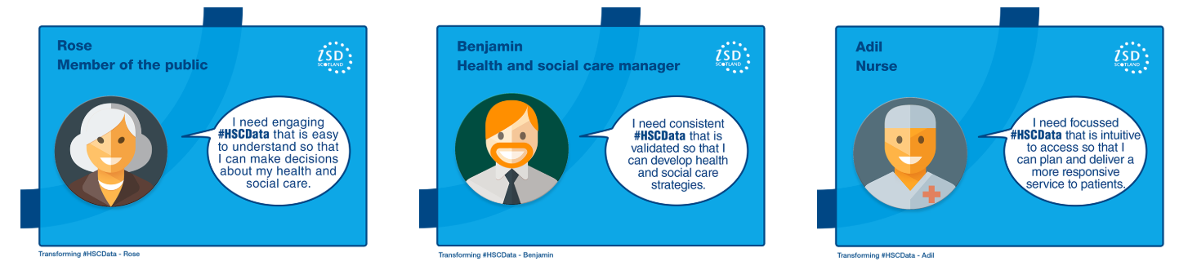

Make it Count

Slide 9
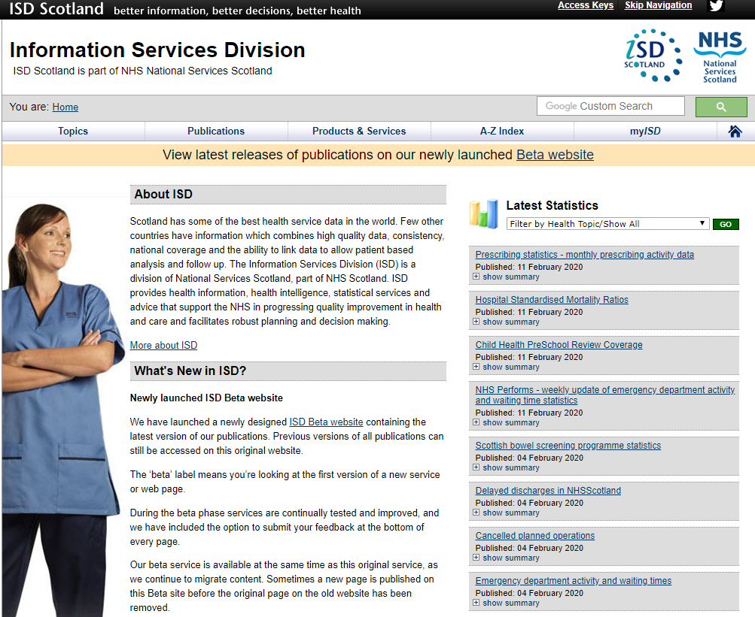
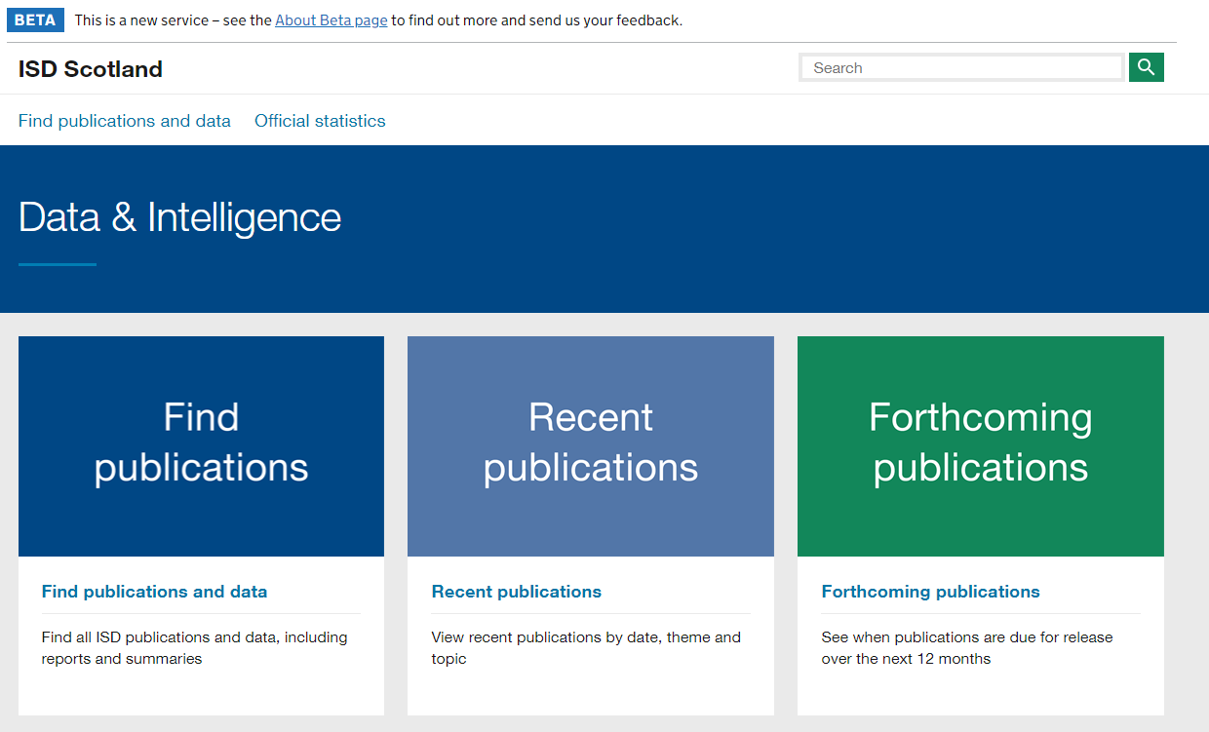
Make it Count

Slide 10
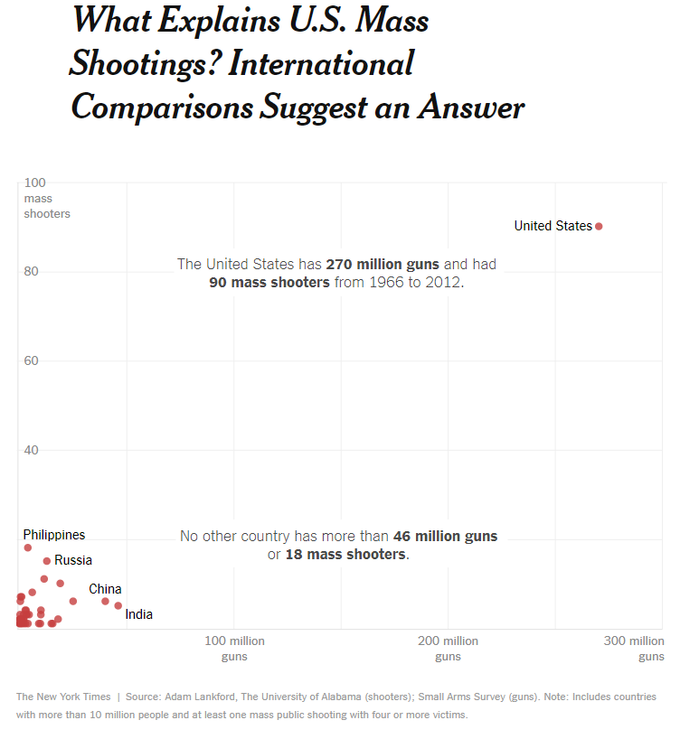
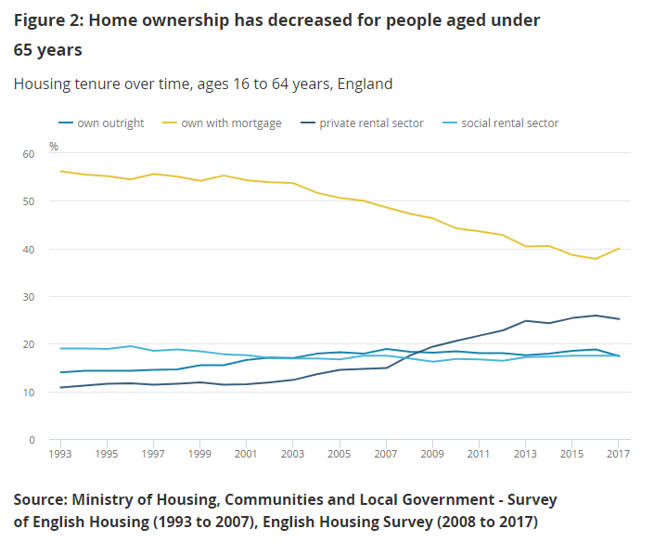
Tell the Story
Source: https://www.nytimes.com/2017/11/07/world/americas/mass-shootings-us-international.html

Slide 11
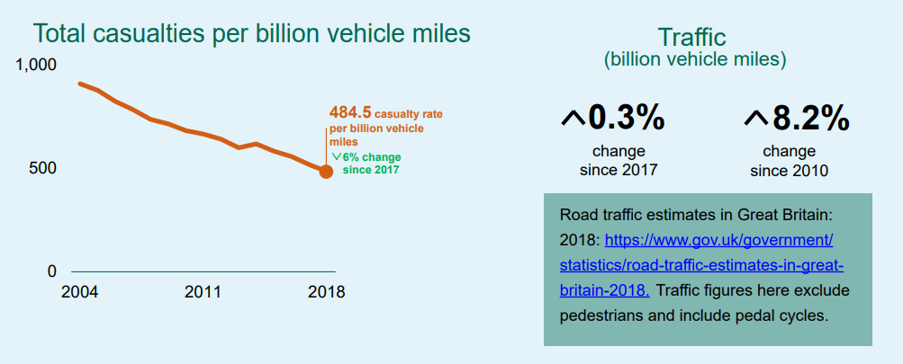
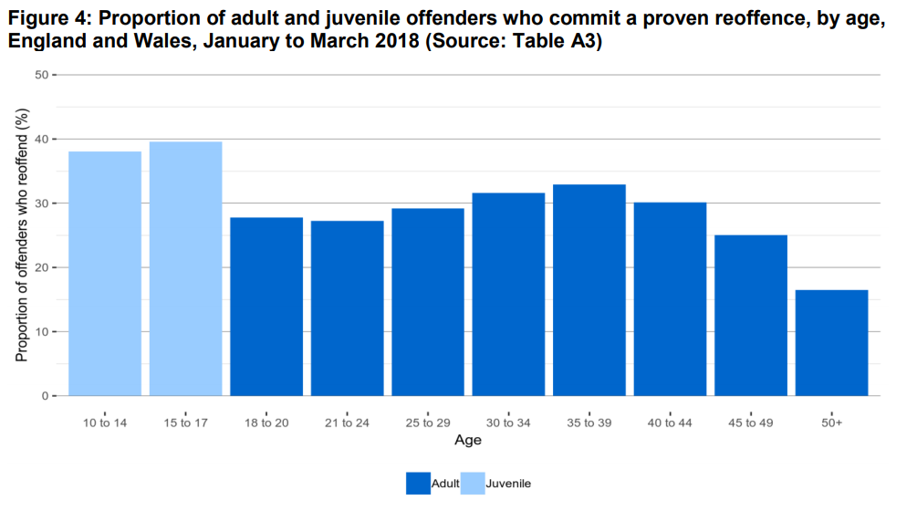
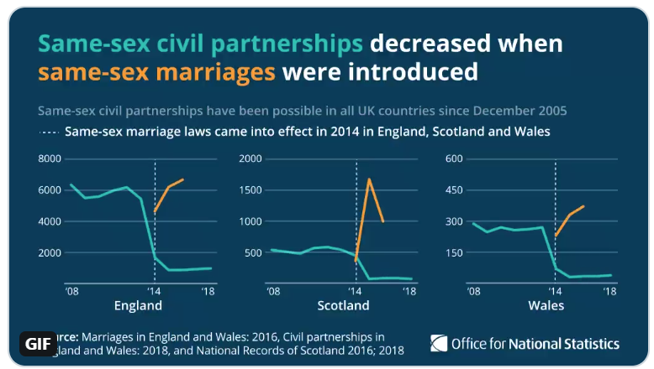
Tell the Story
Source: DfT
Source: MoJ

Slide 12

Show the Uncertainty
Show the process – make it comprehensible
Describe the quality, so users know how good it is
Tell them what they can and can’t do
Finally – if there is something really important they need to know about quality and uncertainty, make it prominent and upfront!

Slide 13
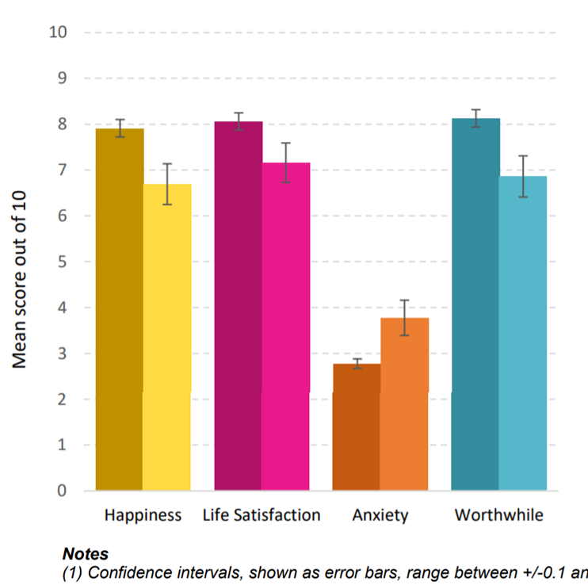
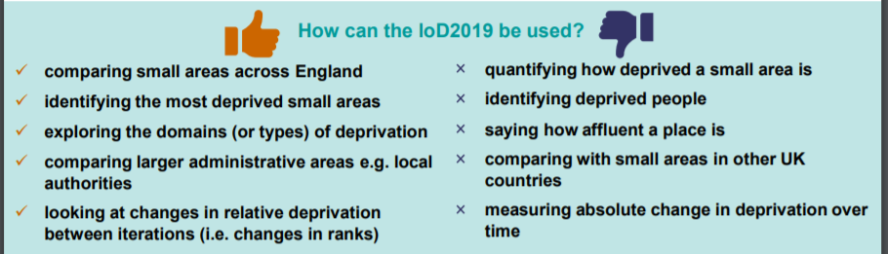
Show the Uncertainty
Figure 2: Mean wellbeing scores for those with and without limiting illness or health condition lasting or expect to last 12 months or more, April 2014 to March 2015
Source: MHCLG
Source: DCMS

Slide 14

Any Questions?
National.Statistician@Statistics.Gov.UK

Slide 15
Journalistic uses of data
Alex Homer – BBC data journalist

Slide 16
Parallel training courses session
Introduction to Data Visualisation - Mayor 2
Writing about Statistics - Duke 1
Communicating quality, uncertainty and change - Duke 2
Introduction to Reproducible Analytical Pipeline - Earl
Promotional room - Baron

Slide 17
Peer reviews of National Statistics
Identifying, highlighting and sharing best practice across the Government Statistical Service

Slide 18
Peer reviews of National Statistics
Why, how, who and when?
Your input
Questions

Slide 19
Peer reviews of National Statistics
Why?
To highlight examples of excellence and share these across government

Slide 20
Peer reviews of National Statistics
Why?
To provide Best Practice and Impact division support to statistics producers

Slide 21
Peer reviews of National Statistics
Why?
To build a network of experienced peer reviewers with knowledge of a wide range of GSS outputs

Slide 22

Peer reviews of National Statistics
How?
Team of 60 peer reviewers
Best Practice and Impact Division
GSS Presentation, Harmonisation, Quality and Geography Champion Networks

Slide 23







Peer reviews of National Statistics
How?
Sample of ~400 National Statistics publications

Slide 24

Peer reviews of National Statistics
How?
List of criteria for peer reviewers to highlight:
Examples of excellence
Good practice
Areas for improvement

Slide 25


Peer reviews of National Statistics
How?
Criteria based on established good practice
Effective graphs and tables
Communicating quality, uncertainty and change
Writing about statistics
And the Code of Practice for Statistics TQV

Slide 26

Peer reviews of National Statistics
How?
Short peer review report sent to producers highlighting good practice and providing actionable feedback or further support to aid improvement, where needed

Slide 27
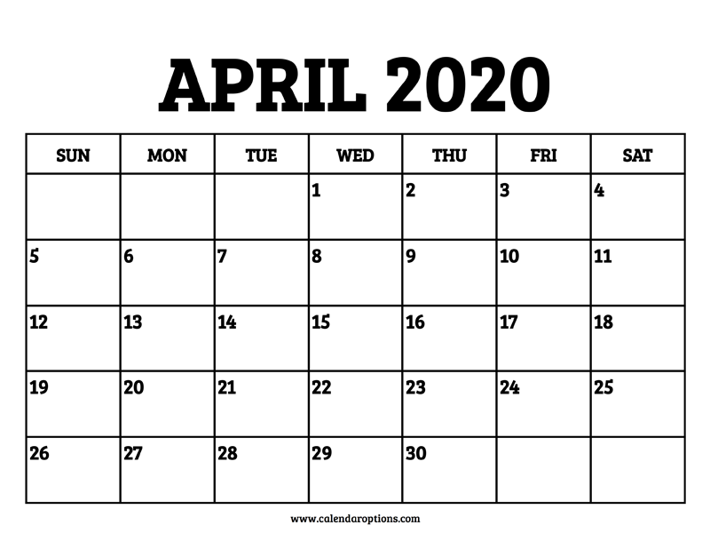
Peer reviews of National Statistics
When?
X

Slide 28
Peer reviews of National Statistics
Over to you…
Sharing best practice
  How best to share examples of excellent practice to the wider GSS and Analysis Function?
  How would you like to see or hear about examples of good practice?
You can record your ideas on the flipchart paper and post-its on your tables

Slide 29
Peer reviews of National Statistics
Over to you…
Beyond National Statistics publications
  What else would you like to see peer reviewed?
Place the types of outputs in order of importance and label 1st, 2nd, 3rd etc..
Use the blank cards to add anything we’ve missed

Slide 30
Thank you
Questions and comments welcome
goodpracticeteam@statistics.gov.uk

Slide 31
Presentation and Dissemination Committee awards

Slide 32
Who are the presentation and dissemination committee (PDC)?

Slide 33
Presentation & Dissemination Committee
Provides strategic and operational direction across the GSS;
Committee meetings are attended by departmental PDC members
Chair: Julie Stanborough (ONS)
PDC has three integral sub-groups
Presentation
sub-group
Chair: Catherine Hope (DWP)
Open Data
sub-group
Chair: Darren Barnes (ONS); Richmond Davies (NHS ISD)
Web Dissemination
sub-group
Chair: John Wilkins
(DFT)
Presentation champions
Each department has a presentation champion(s) to help up drive up presentation standards
Open Data champions
Each department has an open data champion(s) to improve open data standards
Web Dissemination champions
Each department has a web dissemination champion(s) to ensure effective statistical dissemination on web platforms

Slide 34

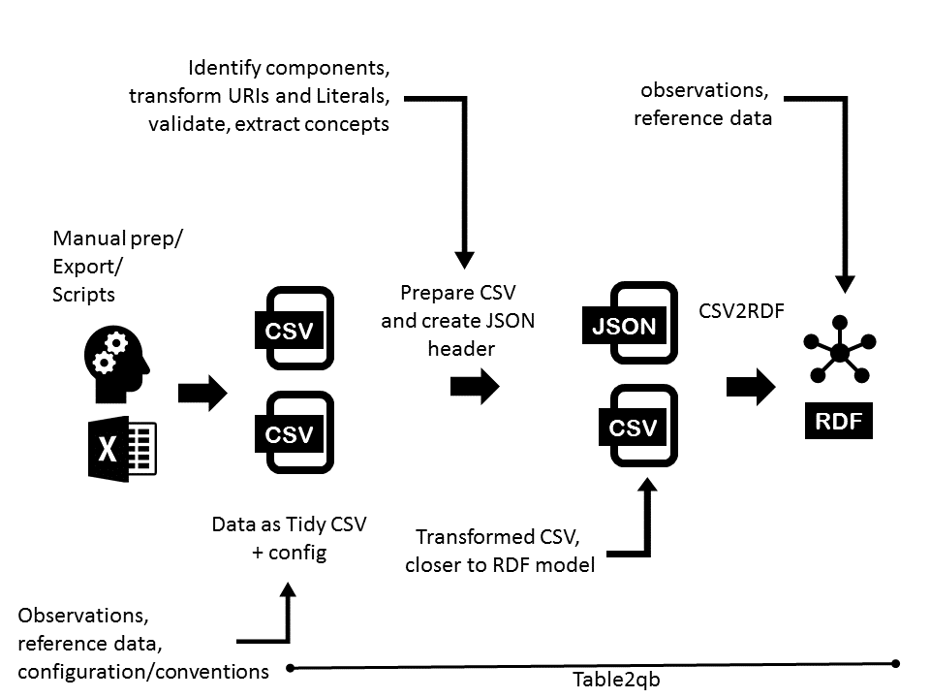
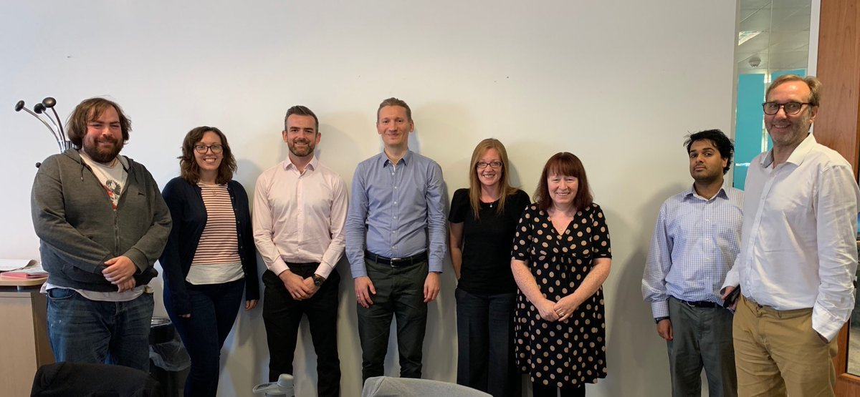


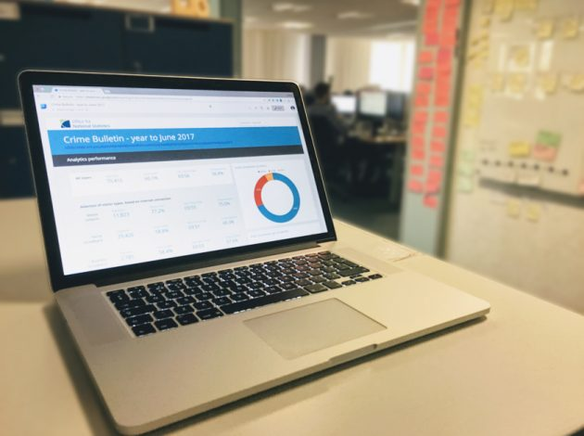
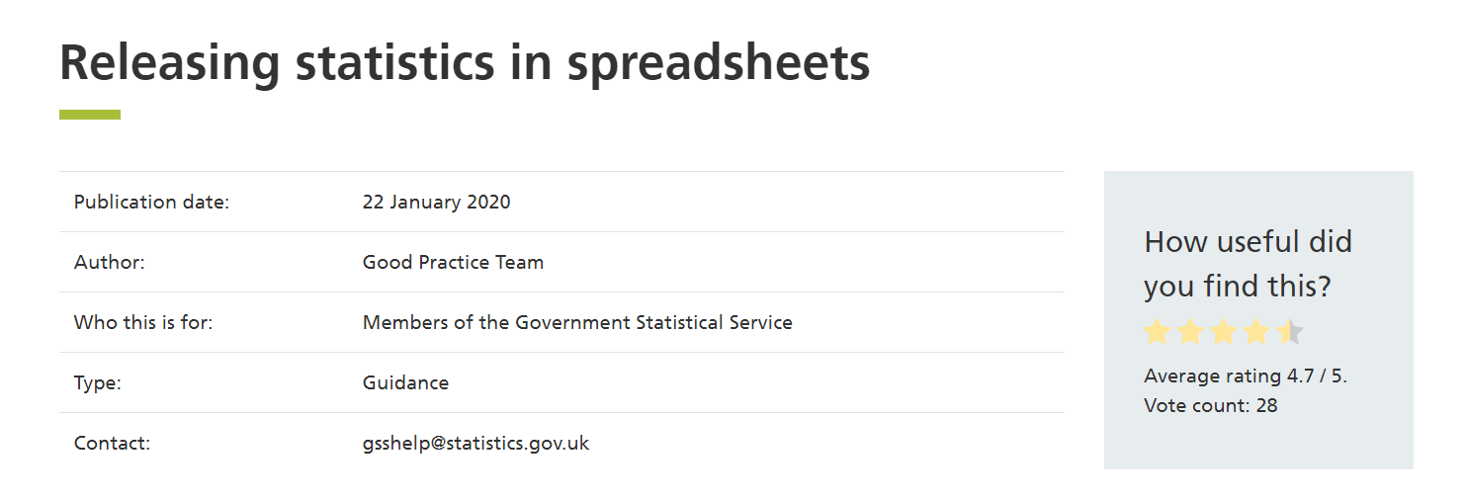
Delivering peer review workshops
What have we achieved?
Improving statistical bulletins
Updating guidance

Slide 35
Down to the awards…

Slide 36

Our first runner up…
Department for Work and Pensions

Slide 37

Our second runner up…
Office of Rail and Road

Slide 38

And the winner is…
Department for Education

Slide 39
Connected Open Government Statistics (COGS)
Darren Barnes – Office for National Statistics

Slide 40
Improving our statistical bulletins
Darren Waters – ONS Digital Publishing

Slide 41
Scottish Household Survey Comic
Conor Nangle – Scottish Government

Slide 42

Extending the reach of our statistics
Conor Nangle

Slide 43


Slide 44

What is the SHS?
http://www.gov.scot/SHS/

Slide 45






Some findings from the SHS 2018
65% of adults in 2018 thought that climate change is an immediate and urgent problem
100% of adults aged 16 to 24 used the internet in 2018.

Slide 46
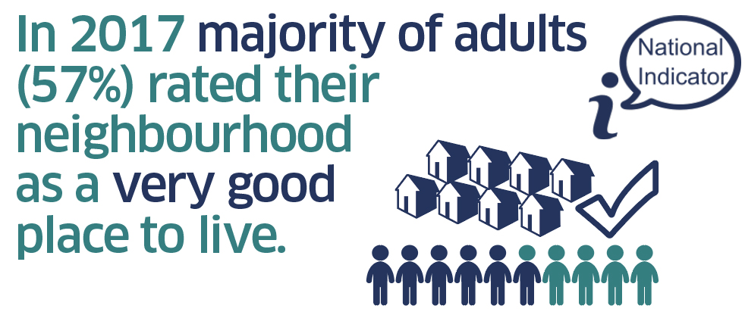
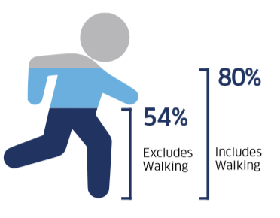
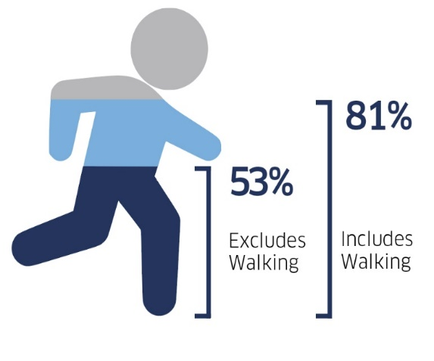
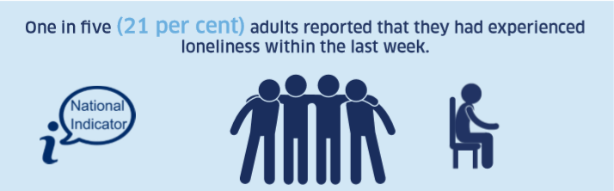

Ratings of neighbourhoods have been consistently high with 90% of adults viewing their neighbourhood as a very or fairly good place to live in 2018
80% of adults had taken part in physical activity and sport in the previous four weeks

Slide 47
Scottish people
Interviewers
Surveyors
Scottish Government
Politicians
Ipsos Mori
Academics,
charities, local authorities

Slide 48
Why we did what we did?
Strategic direction
Falling response rates
Created easily accessible outputs for interviewers and people

Slide 49


SHS in the Past

Slide 50
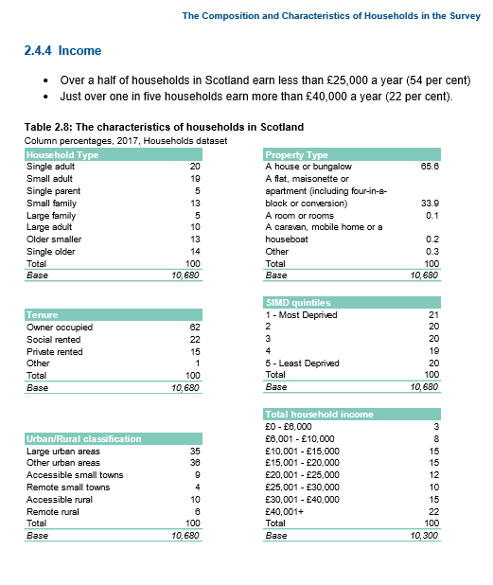

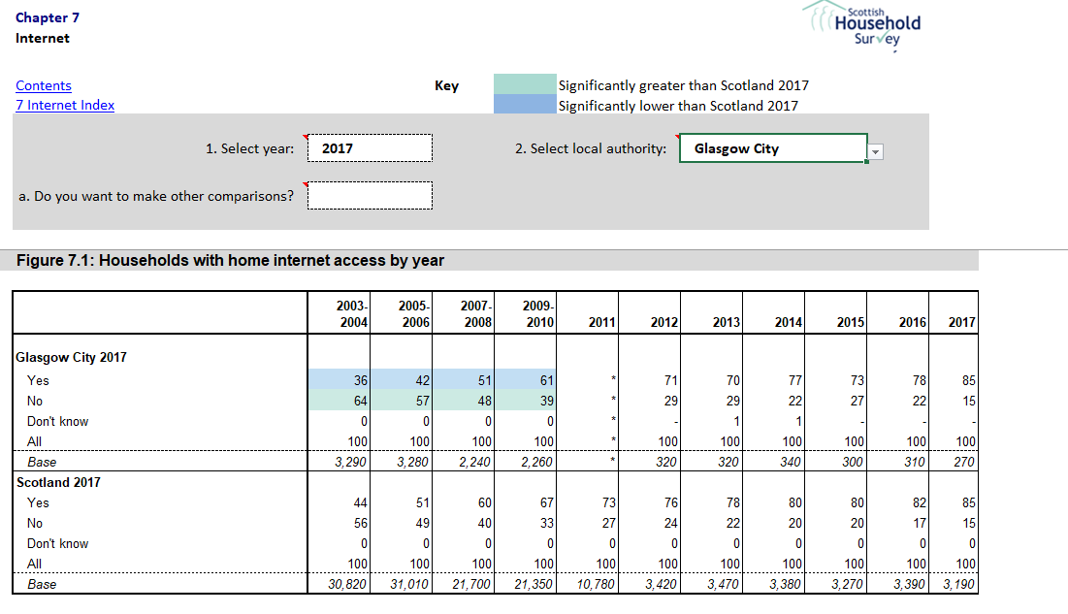
Previously …
Three Publications:
Methodology and Fieldwork Outcomes Report
Local Authority Tables
Scotland's People Annual Report: Scottish Household Survey

Slide 51
SHS Now

Slide 52
Still three main publications
But also…

Slide 53
Animation
http://www.gov.scot/SHS/

Slide 54
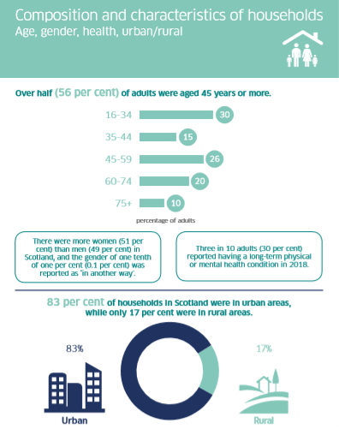
Key Findings Report
45 page infographic style report
Focusses on the National Indicators in the SHS

Slide 55

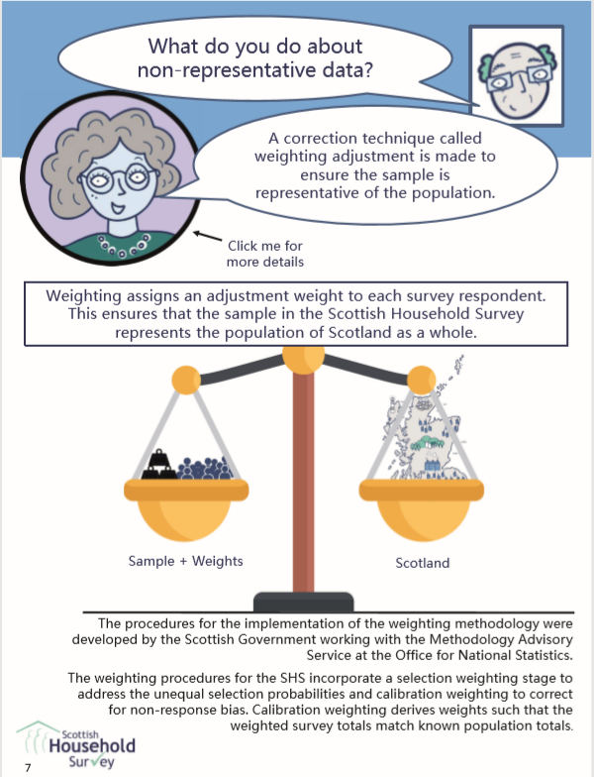
Behind the Numbers

Slide 56
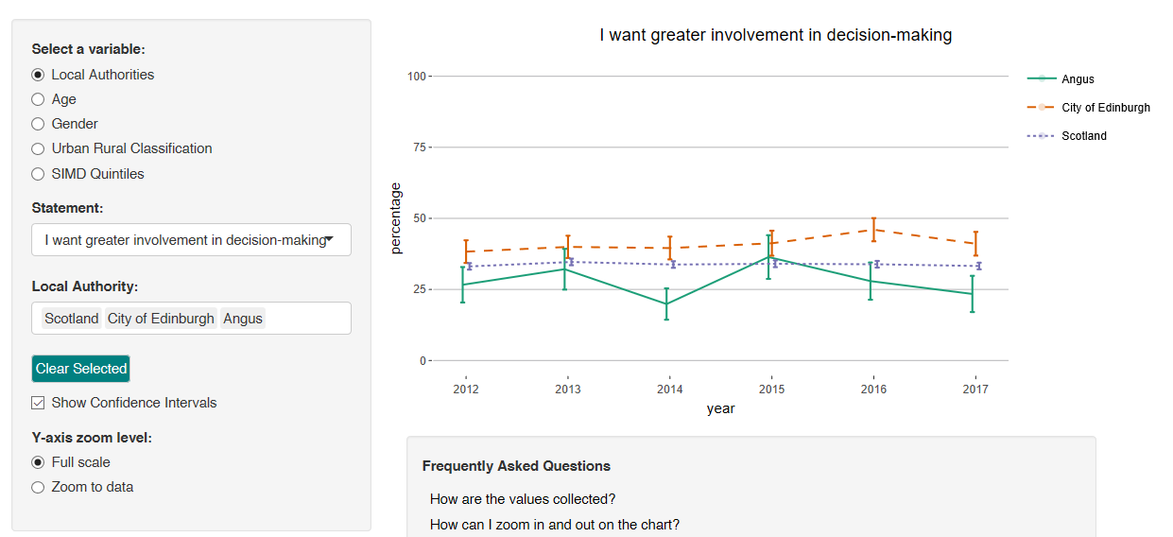
Local Authority Services and Performance Dashboard

Slide 57


A Single Step – Physical activity report
9 page story-telling report, mixing quantitative and qualitative
A story of a single person, with SHS physical activity stats mixed in

Slide 58
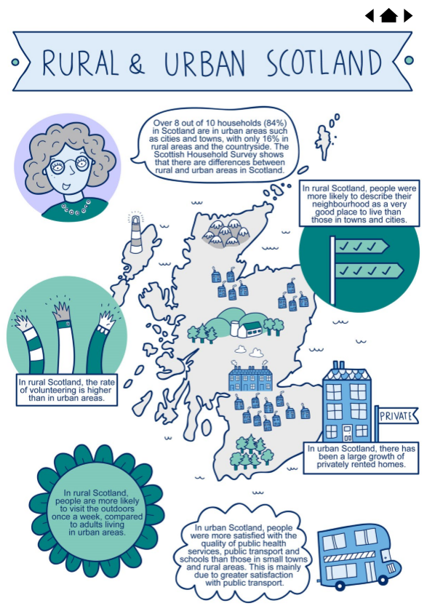
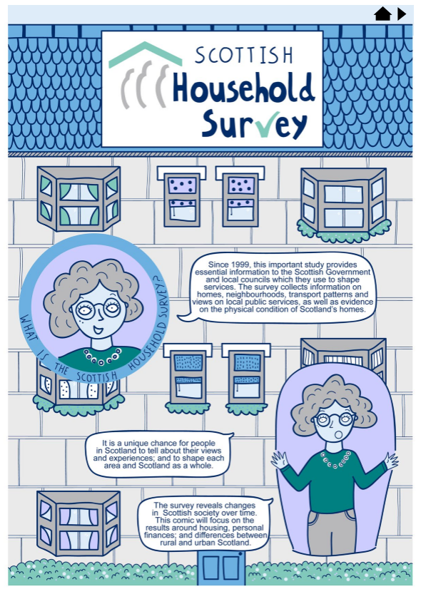
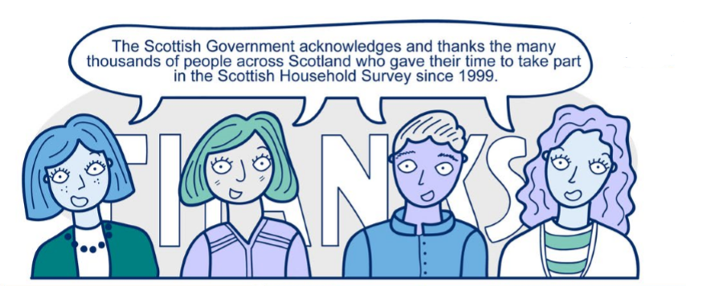
SHS Data Comic
Used to heighten awareness of the survey and to increase survey participation.
It will also extend the audience of the survey results beyond stakeholders and academics by creating easy-to-follow statistical output, making the survey results accessible to the general public.

Slide 59
Scottish Household Survey
comic film

Slide 60
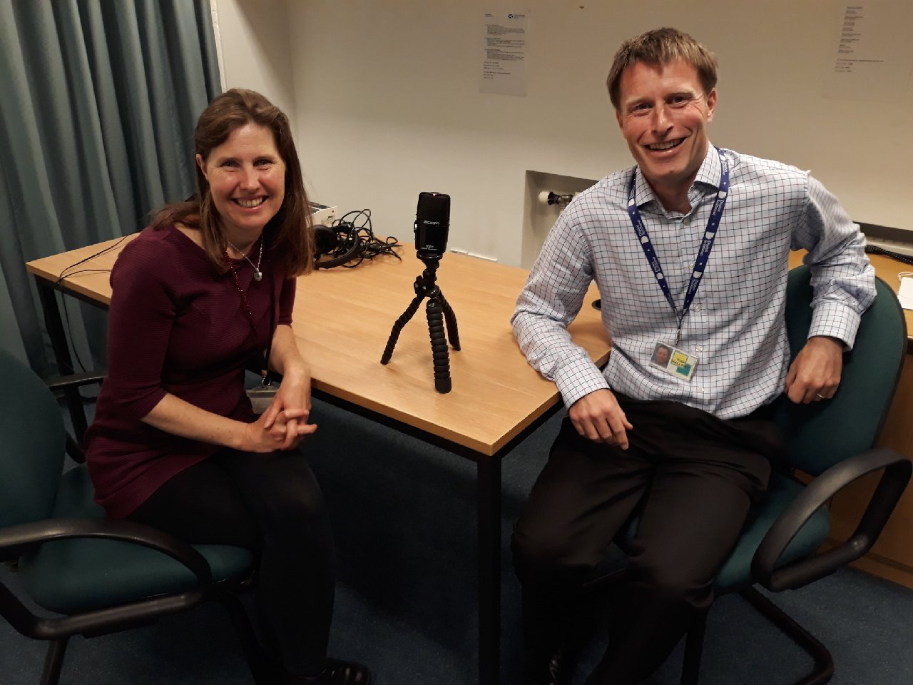
Podcast

Slide 61

Quiz

Slide 62

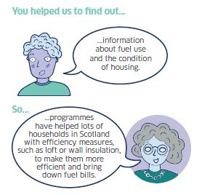

Uses postcards and improved advance materials

Slide 63
Scottish Household Survey film

Slide 64

Incentive Experiment

Slide 65
The things I didn’t have time to show you…
SHS Climate Change Topic Report
Bespoke report – Fife
Local Authority R shiny Dashboard
Quiz
Incentive experiment
And many more…

Slide 66

IMPACT…

Slide 67


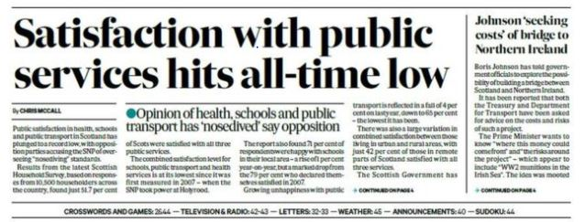
13 media articles which directly reference the SHS, double the previous year
Increased Media Coverage

Slide 68
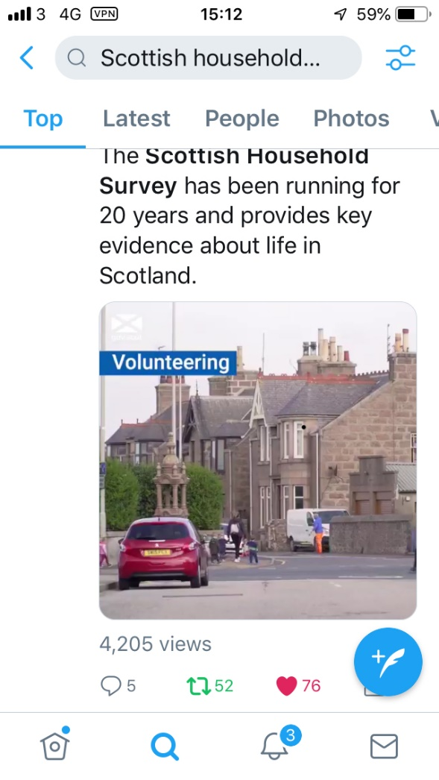
Twitter and Facebook
Film received 4,205 views on Twitter and 2,500 on Facebook

Slide 69

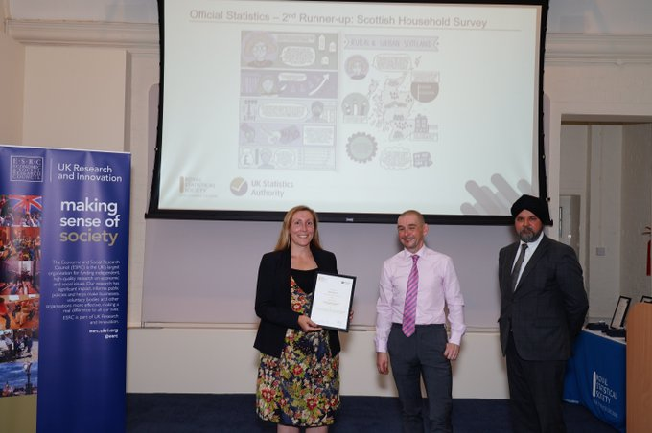
Awards

Slide 70
Response rate trends maintaining
64%
in 2017
First issue response rate up from 48% to 54%

Slide 71
How on earth did we do it all!?

Slide 72
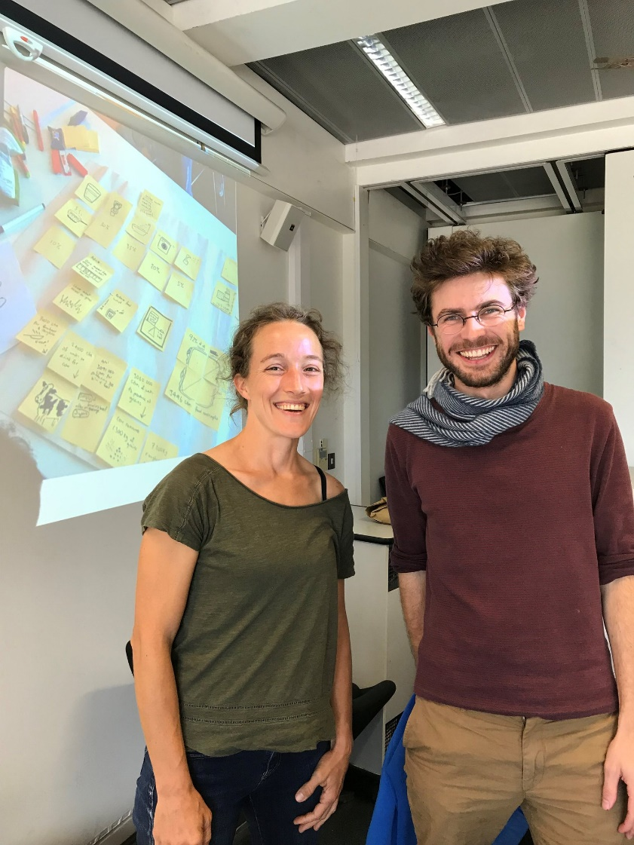


Made new alliances

Slide 73

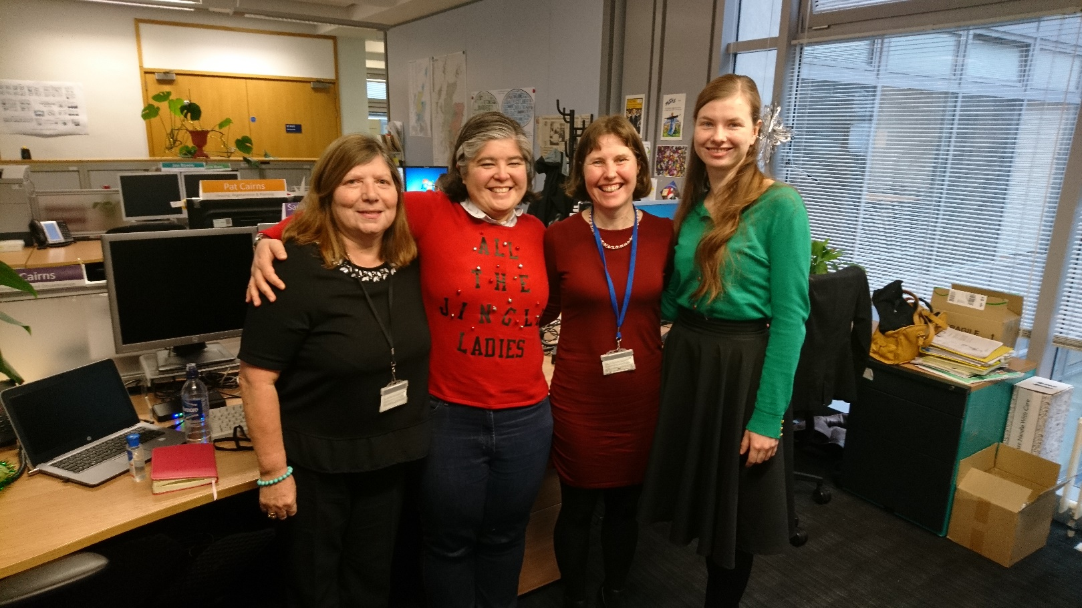
Brainstorming…

Slide 74
What is next for the SHS…
Social Capital topic report
Young people’s report (year of young people)
Engagement week
New data comic - 20 year anniversary
New Local Authority RAP report
Q-step academy
and business as usual …

Slide 75
LINKS TO SHS PUBLICATIONS
Main publication page
Scotland's People Annual Report: Scottish Household Survey
Local Authority Tables
SHS Key Findings Summary Report
A Single Step
Methodology and Fieldwork outcomes
Behind the Numbers
SHS Climate Change Topic Report
SHS Data Comic
Animation
Podcast
Local Authority Services and Performance Dashboard
Bespoke report – Fife
Quiz

Slide 76
Contact
Website: http://www.gov.scot/SHS
Email: shs@gov.scot
    Conor.nangle@gov.scot
Twitter: ScotStat (@ScotStat) #ScottishHouseholdSurvey
Mailing list ScotStat Register.

Slide 77

Thanks for listening!

